Slide 1

Introduction to Social Network Analysis: Part 3
Melissa Whatley, Ph.D.
Belk Center for Community College Leadership and Research
North Carolina State University
Spring 2021

Slide 2
Part 3
Review of Peer Effects
Network Analysis of Qualitative Data

Slide 3
Peer Effects
The main idea behind measuring peer effects is that the way data are grouped matter (e.g., students in classrooms)
Examples from your disciplines?

Slide 4
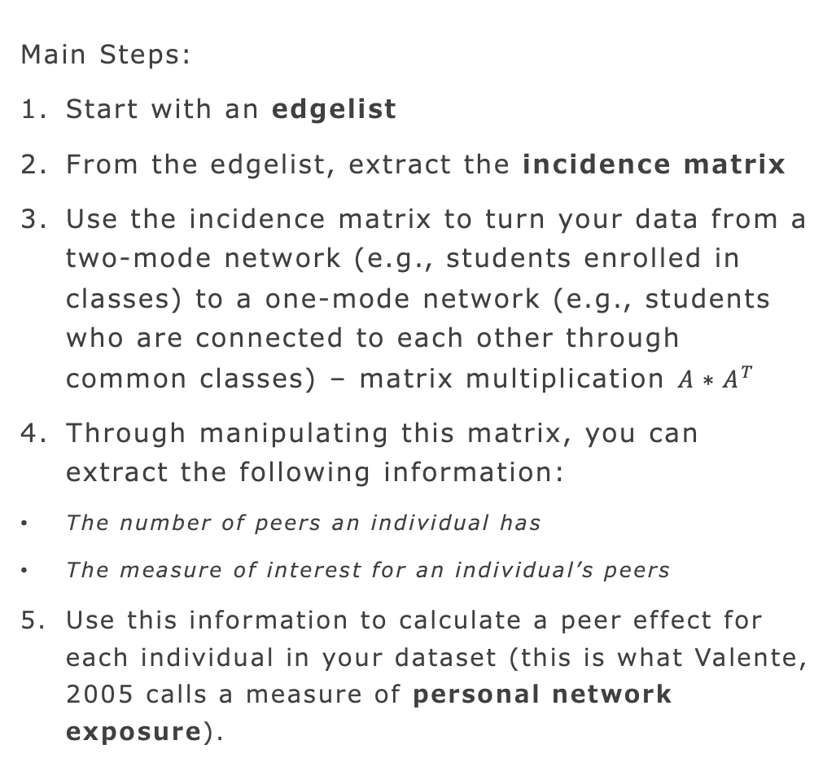
Peer Effects
Main Steps:
Start with an edgelist
From the edgelist, extract the incidence matrix
Use the incidence matrix to turn your data from a two-mode network (e.g., students enrolled in classes) to a one-mode network (e.g., students who are connected to each other through common classes) – matrix multiplication $A∗A^{T}$
Through manipulating this matrix, you can extract the following information:
The number of peers an individual has
The measure of interest for an individual’s peers
Use this information to calculate a peer effect for each individual in your dataset (this is what Valente, 2005 calls a measure of personal network exposure).

Slide 5
Peer Effects
The complexity of measuring peer effects is all in the data cleaning process.
Questions about the code from last time?

Slide 6
Eight Mixed-Methods Applications of Network Analysis (Hollstein, 2014)
Parallel Design (qualitative data collection – e.g., interviews – also involves collection of data needed for network analysis)
Sequential explanatory design (Two phases: Network analysis first or second)
Fully integrated design (Multi-phase research involves collection of network data and other data at the same time)
Embedded design (e.g., using ethnographic data to supplement/help explain network results)

Slide 7
Eight Mixed-Methods Applications of Network Analysis (Hollstein, 2014)
Fuzzy set qualitative comparative analysis (Finds combinations of variables [qualitative codes] that appear in the data and reduces them to a minimum set of inferences)
Semantic network analysis (Connections between qualitative content codes)
Visualization (Conducting interviews based on personal network visualizations)
Simulation (Qualitative observations that inform computer simulations – what would happen if...?)

Slide 8
Semantic Network Analysis
Like drawing a map of qualitative codes
Comparing network structures can provide insight into key concepts that are shared (or not) among groups (Popping, 2000)
Central themes can be identified through the identification of central components in network graphs (Schnegg & Bernard, 1996)

Slide 9
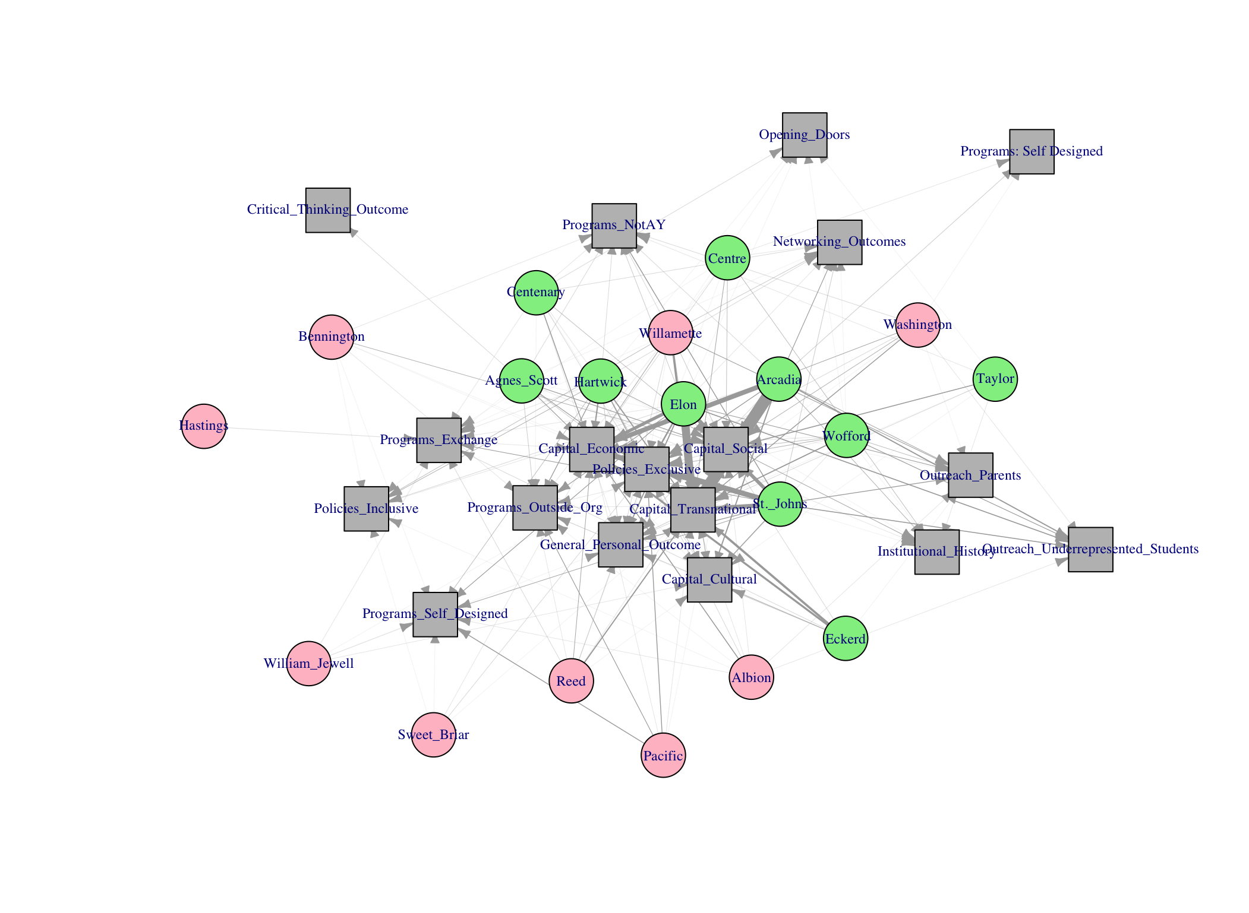
Example 1

Slide 10
Example 2

Slide 11
Preview
The dataset we’ll work with is a list of workshop participants and qualitative codes corresponding to their reasons for enrolling in the workshop
Draw the network
Extract centrality measures
Community detection
Quadratic assignment procedure

Slide 12
Suggested Reading
Domínguez, S., & Hollstein, B. (2014). Mixed Methods Social Networks Research. Cambridge.
Popping, R. (2000). Computer-assisted Text Analysis. Sage.
Schnegg, M. and Bernard, H.R. (1996). Words as actors: A method for doing semantic network analysis. Field Methods, 8(2),7-10
mewhatle@ncsu.edu

